Slide 1
TensorFlow 2.0
Presented by: Dave Ingram

Slide 2
“Machine Learning for all”
Notes:
Just as web development went from code to Wordpress to Wix, Machine learning tools are getting less complex.

Slide 3
“Built to Scale”
Notes:
Just as web development went from code to Wordpress to Wix, Machine learning tools are getting less complex.

Slide 4
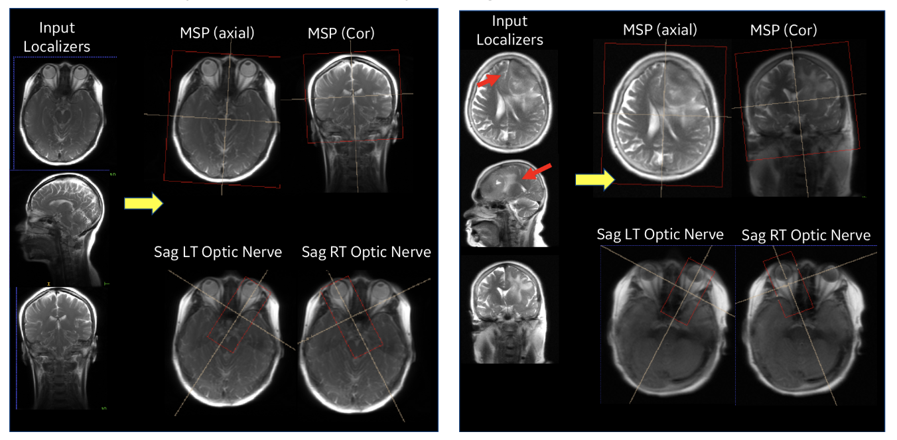
Use Case: GE Healthcare
“trained using a total of 29,000 images .. obtained a classification accuracy of 99.2% on the independent test images .. considered as acceptable for clinical use by radiologists.”
Notes:
https://medium.com/tensorflow/intelligent-scanning-using-deep-learning-for-mri-36dd620882c4
Benefits of TensorFlow
We chose TensorFlow as our development and deployment platform for the following reasons:
Support for 2D and 3D Cascaded Neural Networks (CNN) which is the primary requirement for medical image volume processing
Extensive built-in library functions for image manipulation and optimized tensor computations
Extensive open-source user and developer community which supported latest algorithm implementations and made them readily available
Continuous development with backward compatibility making it easier for code development and maintenance
Stability of graph computations made it attractive for product deployment
Keras interface was available which significantly reduced the development time: This helped in generating and evaluating different models based on hyper-parameter tuning and determining the most accurate model for deployment.
Deployment was done using a TensorFlow Serving CPU based docker container and RestAPI calls to process the localizer once it is acquired.

Slide 5
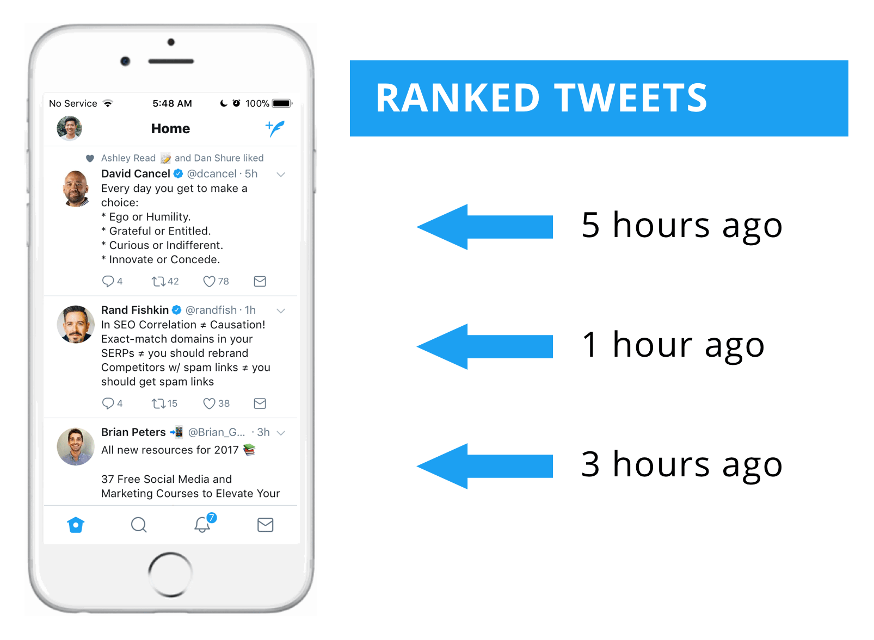
Use Case: Twitter Rankings
“TensorFlow (and TensorFlow Extended) has proven to be a reliable, powerful ecosystem of tools and has enabled our teams to deliver value faster to our users.”
Notes:
https://medium.com/tensorflow/ranking-tweets-with-tensorflow-932d449b7c4

Slide 6
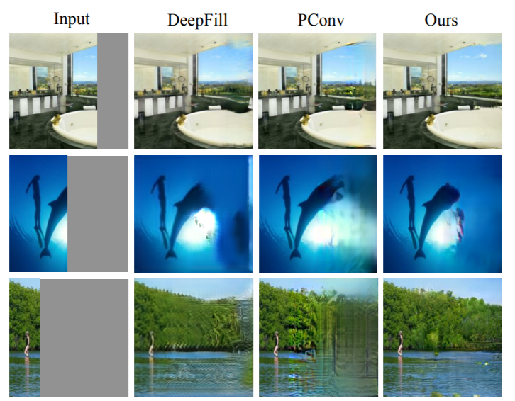
Use Case: Generative Adversarial Networks
“Our model is implemented in TensorFlow .. on 32 cores of a Google Cloud
TPUv3 Pod with batch size 256.
Notes:
https://arxiv.org/pdf/1908.07007.pdf

Slide 7
...and many more
Notes:
Just as web development went from code to Wordpress to Wix, Machine learning tools are getting less complex.

Slide 8
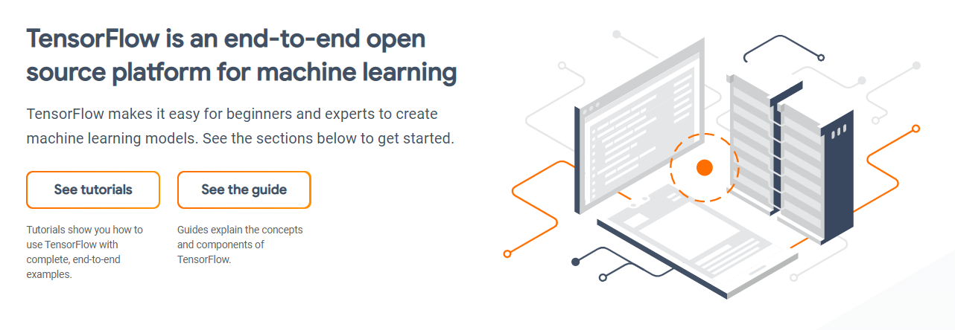
www.tensorflow.org
Notes:
https://medium.com/tensorflow/intelligent-scanning-using-deep-learning-for-mri-36dd620882c4
Benefits of TensorFlow
We chose TensorFlow as our development and deployment platform for the following reasons:
Support for 2D and 3D Cascaded Neural Networks (CNN) which is the primary requirement for medical image volume processing
Extensive built-in library functions for image manipulation and optimized tensor computations
Extensive open-source user and developer community which supported latest algorithm implementations and made them readily available
Continuous development with backward compatibility making it easier for code development and maintenance
Stability of graph computations made it attractive for product deployment
Keras interface was available which significantly reduced the development time: This helped in generating and evaluating different models based on hyper-parameter tuning and determining the most accurate model for deployment.
Deployment was done using a TensorFlow Serving CPU based docker container and RestAPI calls to process the localizer once it is acquired.

Slide 9
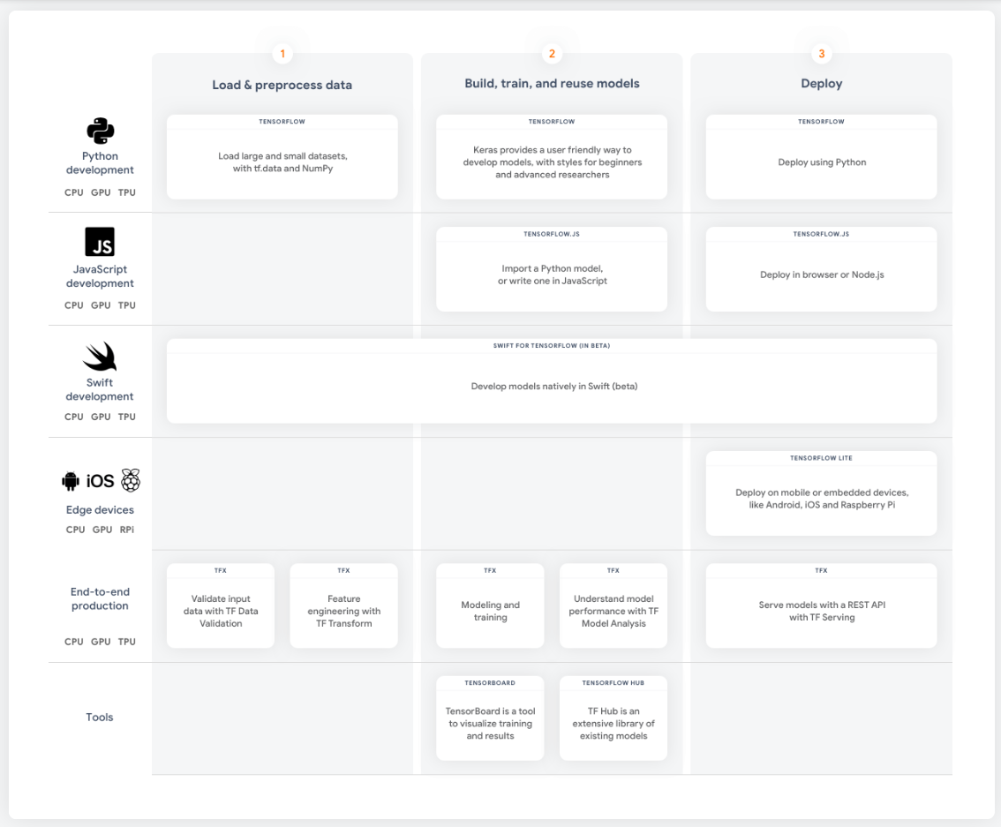
TensorFlow
Ecosystem

Slide 10
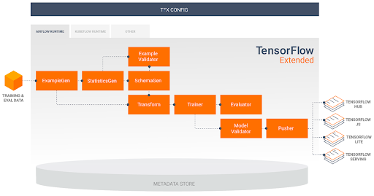
www.tensorflow.org
Notes:
https://medium.com/tensorflow/intelligent-scanning-using-deep-learning-for-mri-36dd620882c4
Benefits of TensorFlow
We chose TensorFlow as our development and deployment platform for the following reasons:
Support for 2D and 3D Cascaded Neural Networks (CNN) which is the primary requirement for medical image volume processing
Extensive built-in library functions for image manipulation and optimized tensor computations
Extensive open-source user and developer community which supported latest algorithm implementations and made them readily available
Continuous development with backward compatibility making it easier for code development and maintenance
Stability of graph computations made it attractive for product deployment
Keras interface was available which significantly reduced the development time: This helped in generating and evaluating different models based on hyper-parameter tuning and determining the most accurate model for deployment.
Deployment was done using a TensorFlow Serving CPU based docker container and RestAPI calls to process the localizer once it is acquired.

Slide 11
Key Concept: Everything’s a Tensor
Rank | Shape | Dimension number | Example
0 | [] | 0-D | A 0-D tensor. A scalar.
1 | [D0] | 1-D | A 1-D tensor with shape [5].
2 | [D0, D1] | 2-D | A 2-D tensor with shape [3, 4].
3 | [D0, D1, D2] | 3-D | A 3-D tensor with shape [1, 4, 3].
n | [D0, D1, ... Dn-1] | n-D | A tensor with shape [D0, D1, ... Dn-1].

Slide 12
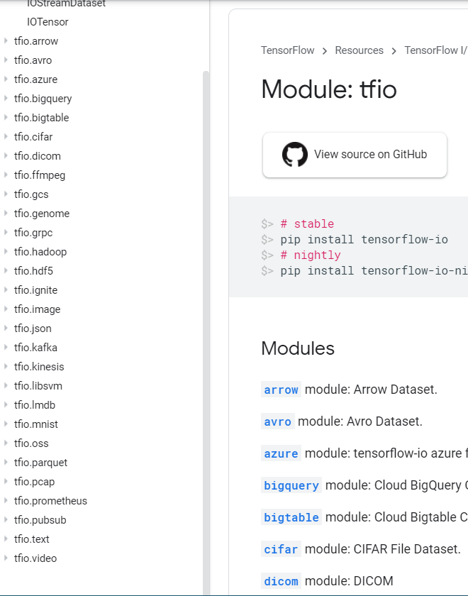
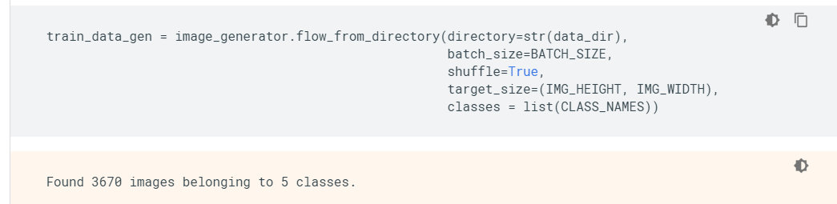
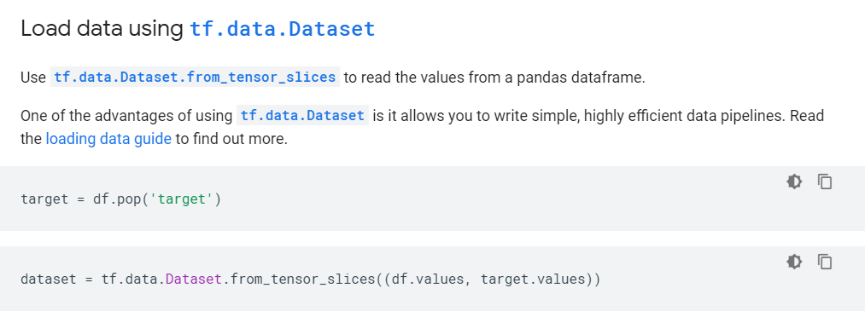
Key Concept: Working with data is familiar

Slide 13
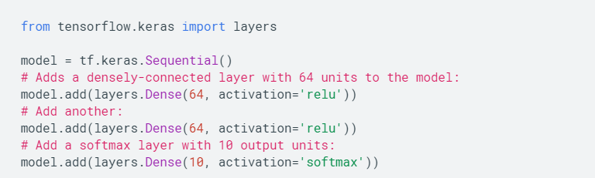
Key Concept: Most models are easy to build

Slide 14
Examples
http://bit.ly/chstensor

